Slide 1
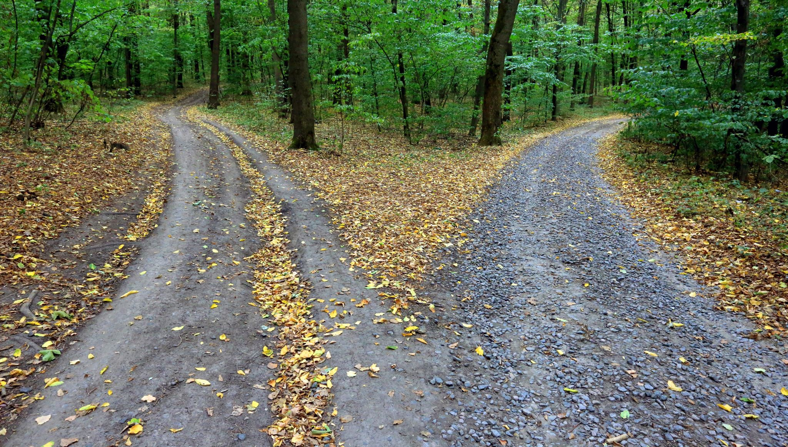

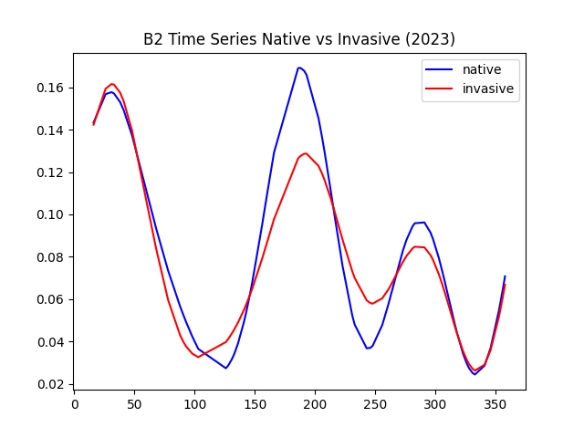
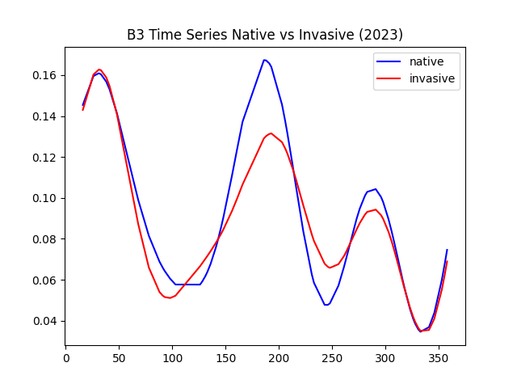
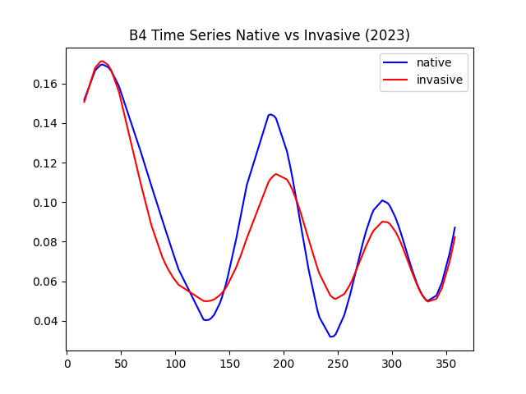
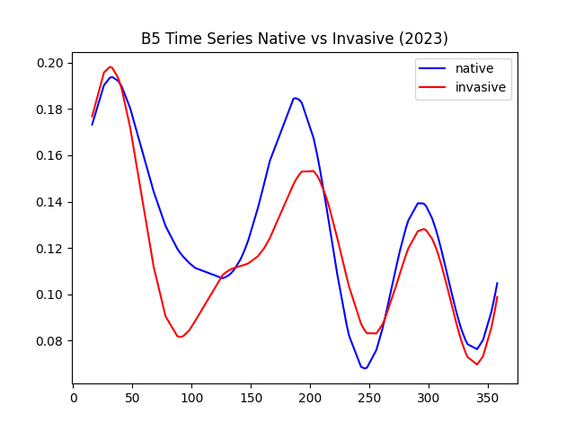
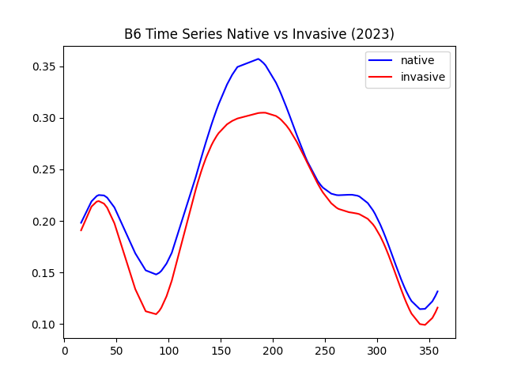
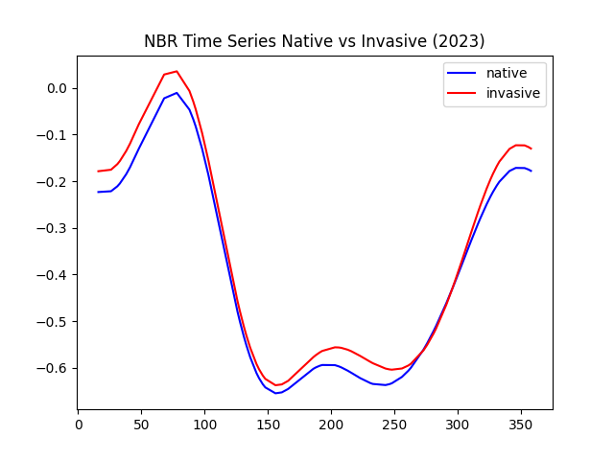
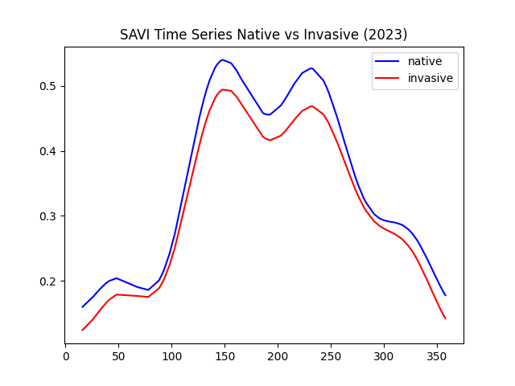
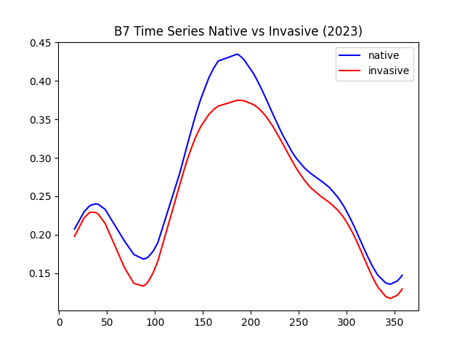
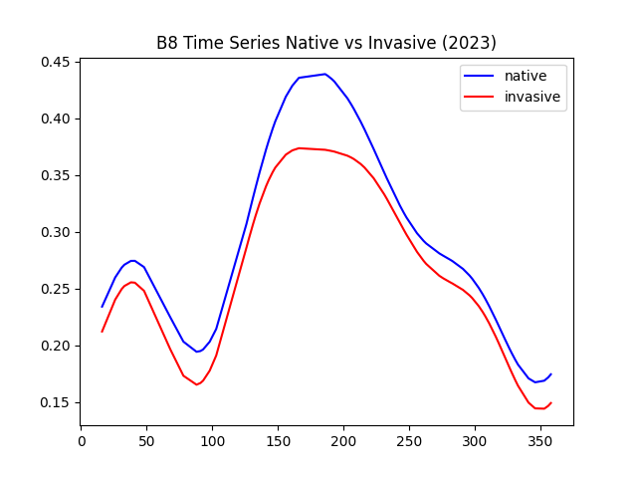
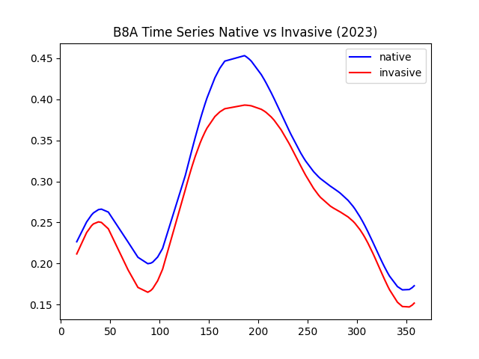
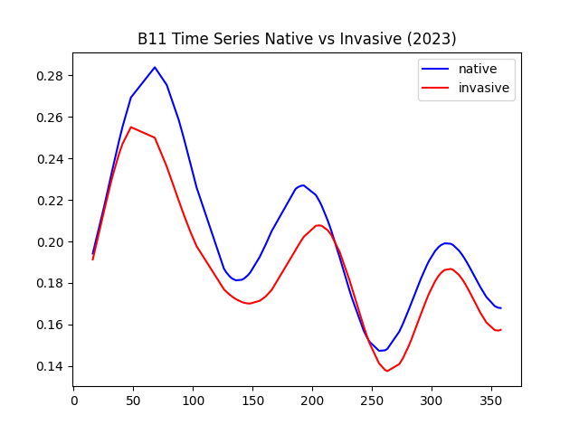
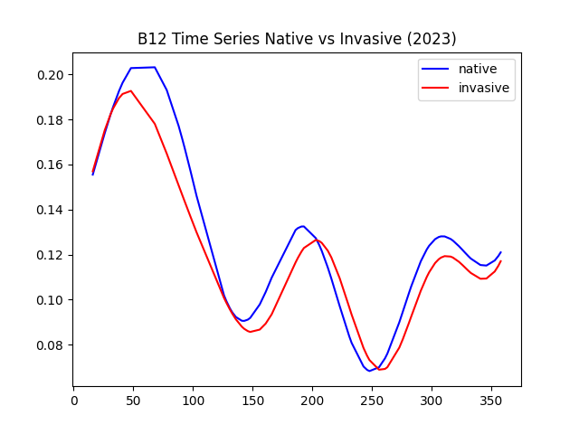
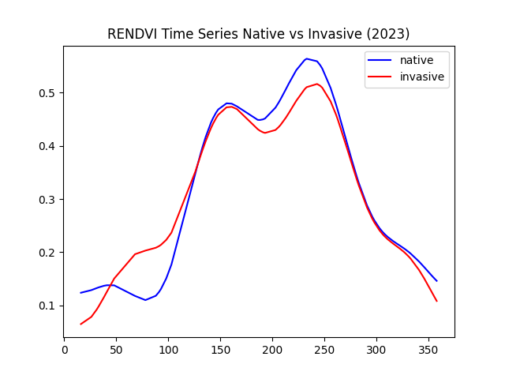
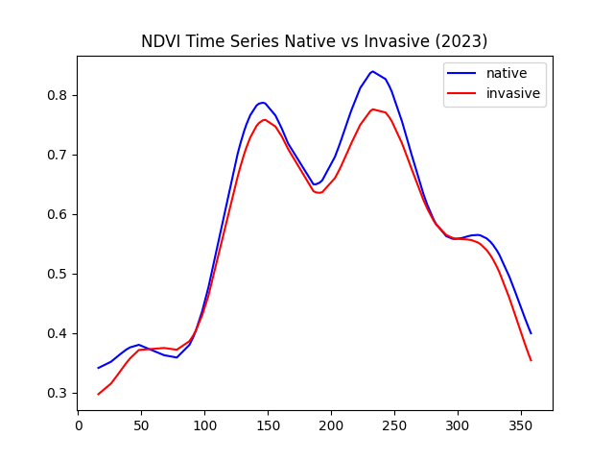
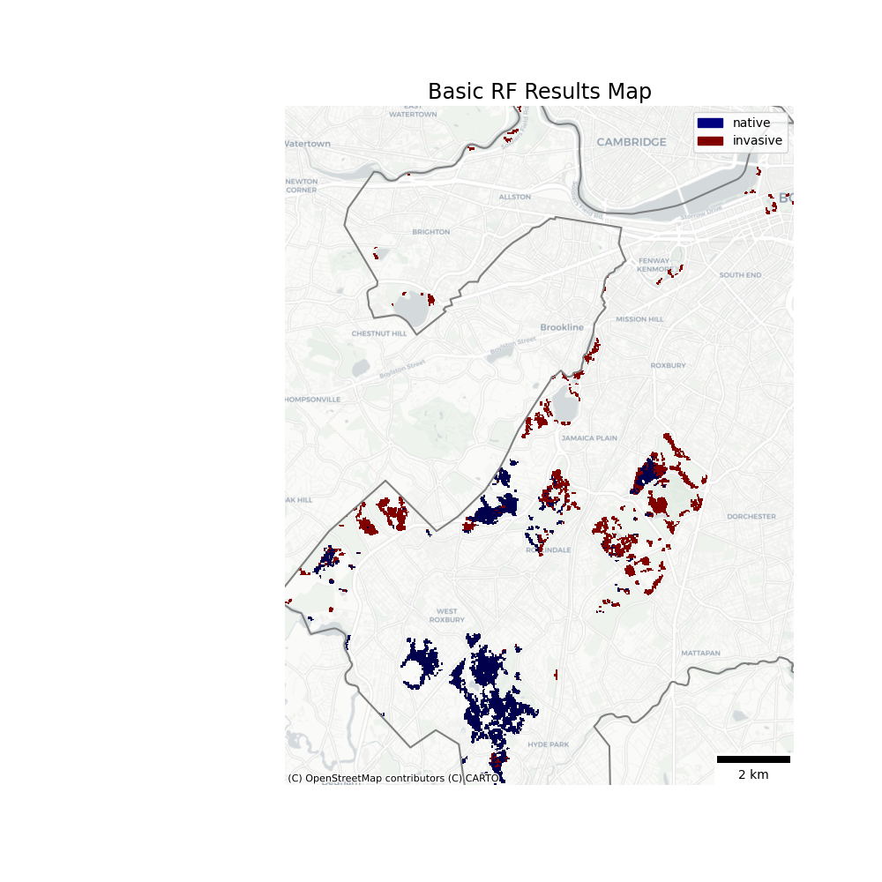
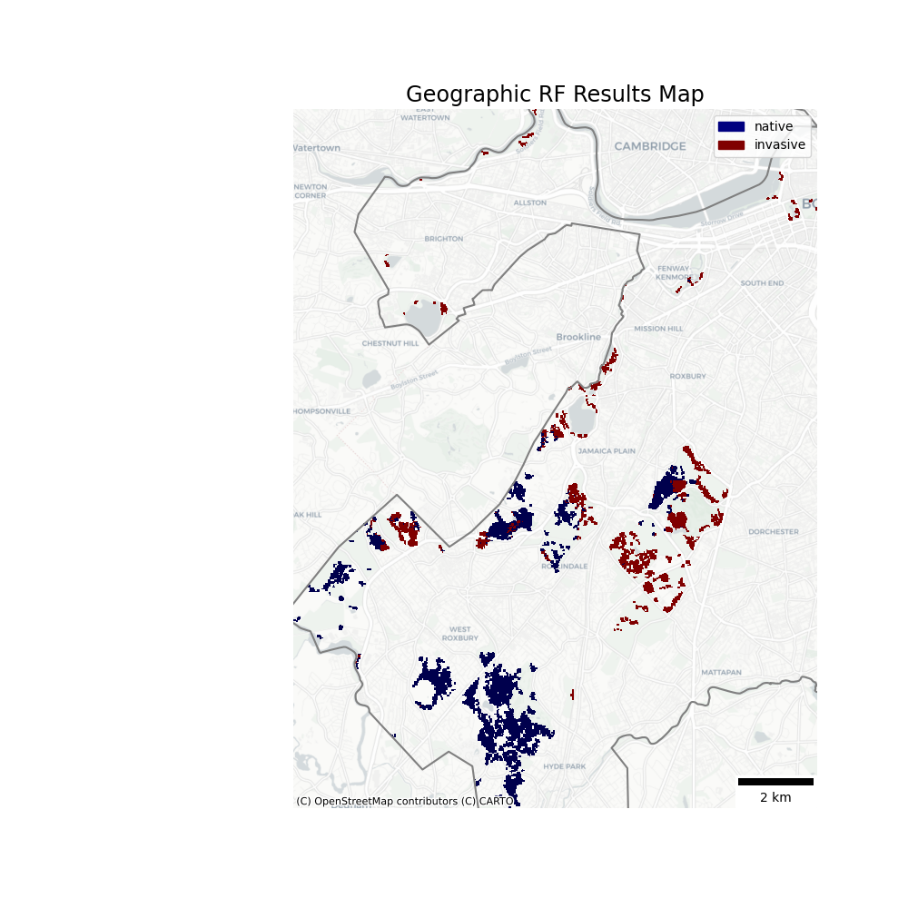
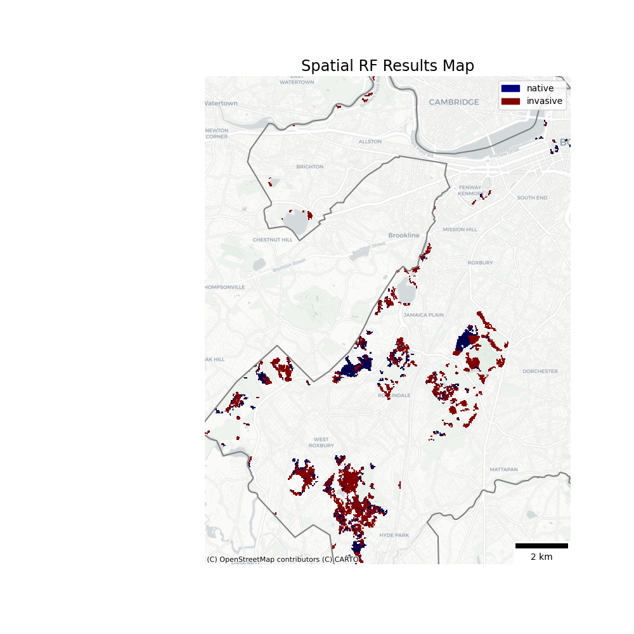
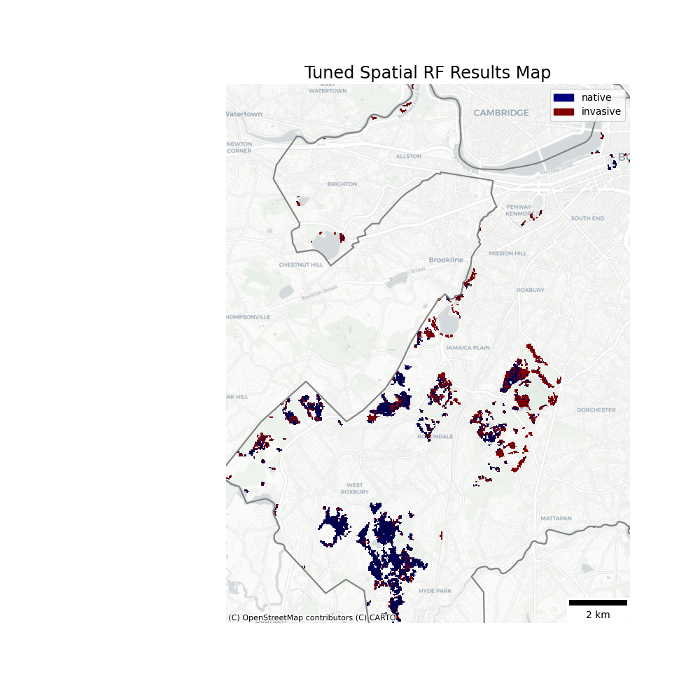
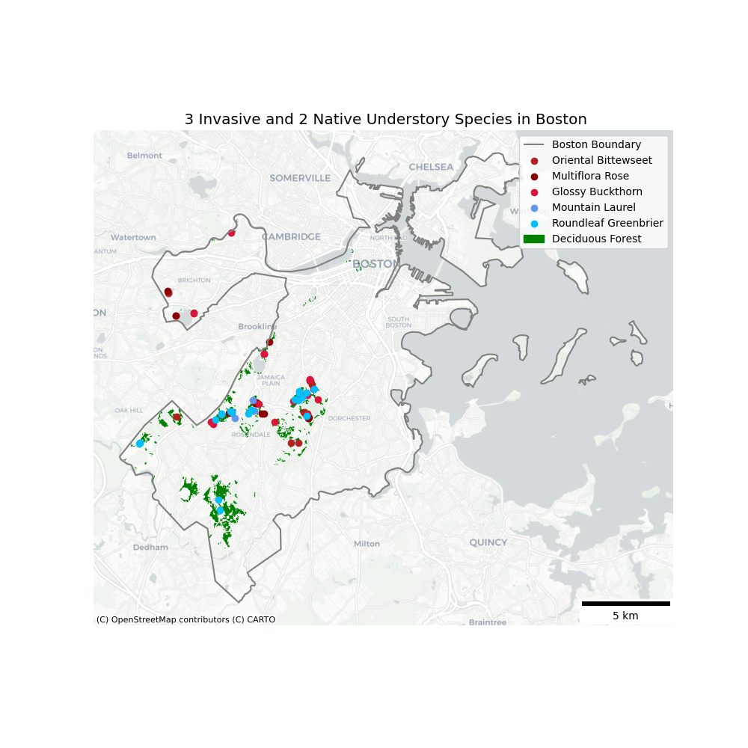
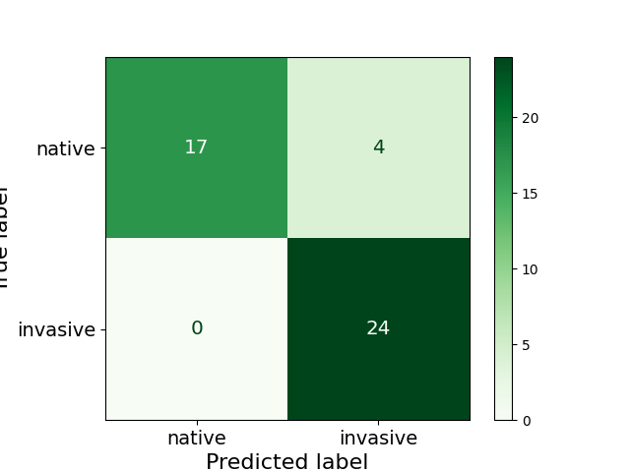
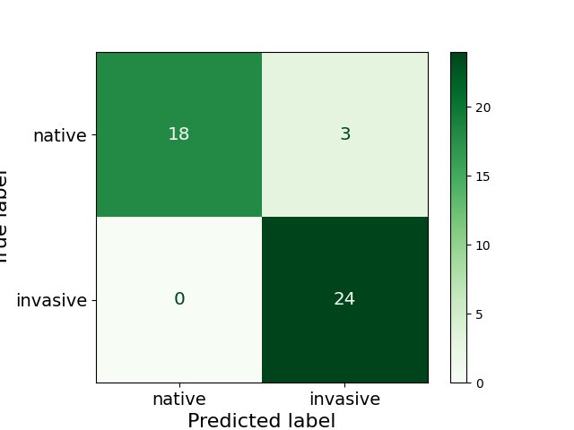
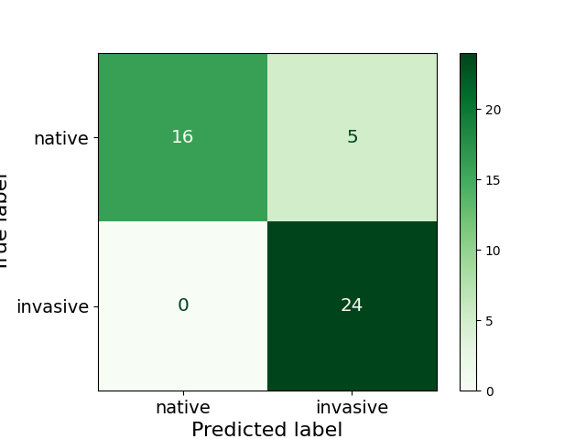
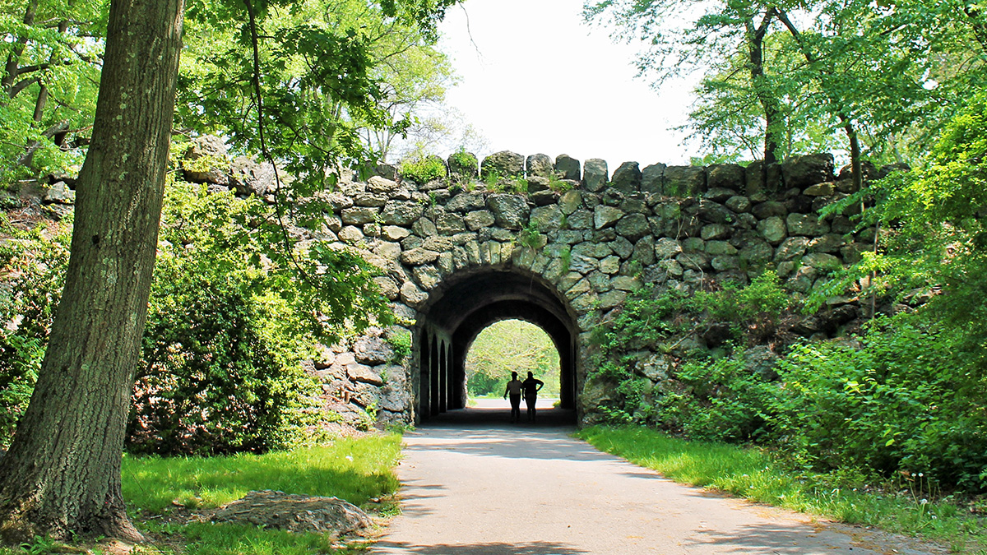
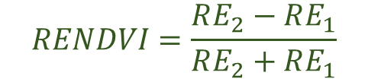
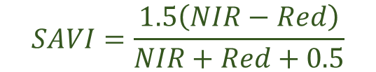


Predicting Invasive Understory Species in Boston’s Deciduous Forest
A Comparison of Random Forest Models with Sentinel-2 Time Series Data
Background
Extracting Seasonality & Phenology
Model Performance
Forest understories provide crucial ecosystem services like ….
Even with the importance of forest understories, detecting invasive species in field campaigns can be difficult…
Remote sensing of understories typically consist of direct and indirect methods like…
First, 4 different indices were calculated in line with work from Yang et al. This included the normalized burn ratio (NBR), soil adjusted vegetation index (SAVI), red edge normalized difference vegetation index (NDVI), and normalized difference vegetation index (NDVI). These indices extract information from two optical bands and can be used to differentiate different land cover classes.
Model performance was assessed by calculating overall accuracy and Cohen’s Kappa. Overall accuracy is the percent of correctly classified sites out of total sites while Cohen’s Kappa is a measure of how well the true and predicted labels agree on a scale of 0 to 1.
$$NBR=\frac{SWIR2−NIR}{SWIR2+NIR}$$
$$SAVI=\frac{1.5\left(NIR−Red\right)}{NIR+Red+0.5}$$
$$RENDVI=\frac{RE_{2}−RE_{1}}{RE_{2}+RE_{1}}$$
$$NDVI=\frac{NIR−Red}{NIR+Red}$$
To provide the machine learning algorithm with measurements of the time series characteristics of each species, 4-th order harmonic regression was conducted to extract annual, semi-annual, 4-month, and 3-month periodicity. This was done for the 4 vegetation indices as well as 10 bands from Sentinel-2. Results did not show a lot of clear separation between invasive and native species, except for the red edge normalized difference vegetation index (RENDVI) and band 5 (B5).
Model | Runtime (s) | Overall Accuracy | Cohen’s Kappa | Predicted Coverage by Invasives
Basic | 0.09 | 91.1% | 0.82 | 41.3%
Geographic | 151 | 93.3% | 0.86 | 34.1%
Spatial | 1.69 | 84.4% | 0.68 | 71.0%
Spatial, tuned | 1.58 | 86.7% | 0.73 | 34.6%
Methodology
Pre-process Sentinel -2 imagery from Google Earth imagery
Filter, mask, and clip to study area; mosaic same-day tiles together
Pixelwise 4-th order harmonic regression fit in SciPy to extract seasonality
Collect iNaturalist training data
Discussion
Train 4 different random forest models
Evaluate performance of each model on test with confusion matrices
Predictions
It is not clear that introducing spatial data into the RF was particularly helpful for classification accuracy.
Geographic was clearly really slow so spatial, tuned is a better idea.
Number of spatial neighbors is super important for total predicted area of invasives.
Not a lot of clear departure was apparent in most of the input bands and indices. Perhaps this is why machine learning was needed, higher resolution imagery (forests are super fragmented in Boston),…
Training Data
The following random forest (RF) models were trained on 70% of the training data from iNaturalist, tested on 30% and used to predict the rest of the pixels in the study area that were not in the iNaturalist observations:
Basic RF: no spatial information is provided
Geographic RF: developed by Georganos et al. to account for spatial autocorrelation and heterogeneity by training sub-RFs on spatial subsets of the data
Spatial RF: a more efficient method of geographic RF that instead trains individual decision trees on subsets of the data and weights training data by its distance from the center of the subset
Spatial RF, tuned: same as above but tuned for number of neighbors to create the lowest error
iNaturalist is a global online database of citizen science observations of species. Using pyinaturalist to access to the website’s API, the locations of 5 important understory species in New England deciduous forests were collected for 2021 – 2024. The 2 native species selected were mountain laurel (Kalmia latifolia) and roundleaf greenbrier (Smilax rotundifolia) while 3 the invasive species for training were oriental bittersweet (Celastrus orbiculatus), multiflora rose (Rosa multiflora), and glossy buckthorn (Frangula alnus). These species were selected after consultation with forestry and conservation colleagues and the sites of these species in the study area are mapped below.
Chad Fisher | Advanced Remote Sensing | UEP 294
References:
Yang X, Qiu S, Zhu Z, Rittenhouse C, Riordan D, Cullteron M (2023). Mapping understory plant communities in deciduous forests from Sentinel-2 time series. Remote Sensing of Environment, 293. https://doi.org/10.1016/j.rse.2023.113601
Georganos S, Grippa T, Gadiaga AN, Linard C, Lennert M, Vanhuysse S, Mboga N, Wolff E, Kalogirou S (2019). Geographical random forests: a spatial extension of the random forest algorithm to address spatial heterogeneity in remote sensing and population modelling. Geocarto International, 36(2). https://doi.org/10.1080/10106049.2019.1595177
Wiedemann N, Martin H, Westerholt R (2023). Benchmarking regression models under spatial heterogeneity. GIScience 2023. http://dx.doi.org/10.4230/LIPIcs.GIScience.2023.11
Images: PowerPoint stock images and The Cultural Landscape Foundation

